Slide 1
Optimizing Courier Delivery System
Guide Name: Ms. Deepthi S Narayan
Assistant Professor, Dept of CA
PES University
Subham Singh - PES1201801830
Vijaykumar R Pai - PES1201702013
Ayush Pratyay - PES1201702164

Slide 2
Abstract of the project:
A Software as a service (SaaS) web application where in the system automates the delivery services that can make decisions as to which delivery point should be reached first for feasible ways by taking list of address from all the nearest delivery points.

Slide 3

Motivation:-
Large courier companies use centralized computer systems to delegate delivery jobs to drivers.
If delivery agent carry multiple jobs concurrently these may lead to choose route which may be sub optimal.
Therefore, with this system we tried to automate the courier delivery system which can make decision that which delivery point it should reach first for feasible ways by taking list of address from all the nearest delivery points.

Slide 4

Technologies used
Frontend
HTML5
CSS3
Bootstrap v4.2.1
React.js v16.x
Backend
Node.js 11.8.0
Database (NoSQL)
MongoDB v4.0.1
Cloud Deployment
Heroku Deployment
mLab MongoDB Deployment

Slide 5
What does the System consist of (Main Modules)
ADMIN PANEL
AGENT PANEL

Slide 6
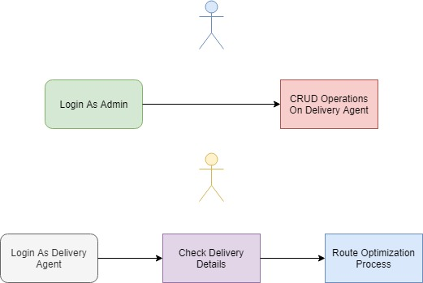
Overview of THE System

Slide 7
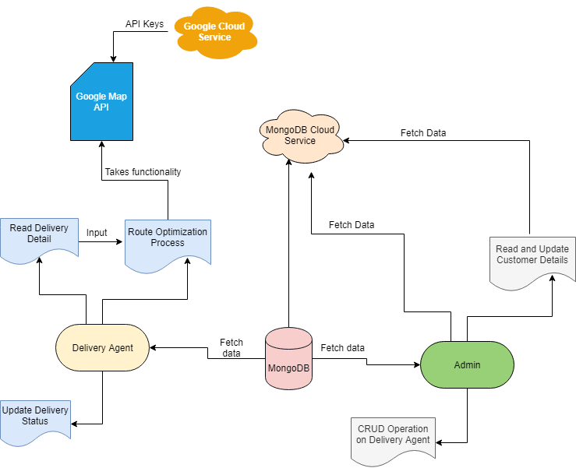
Architecture Of The System
This whole system is being
deployed on Heroku Cloud
Platform.

Slide 8
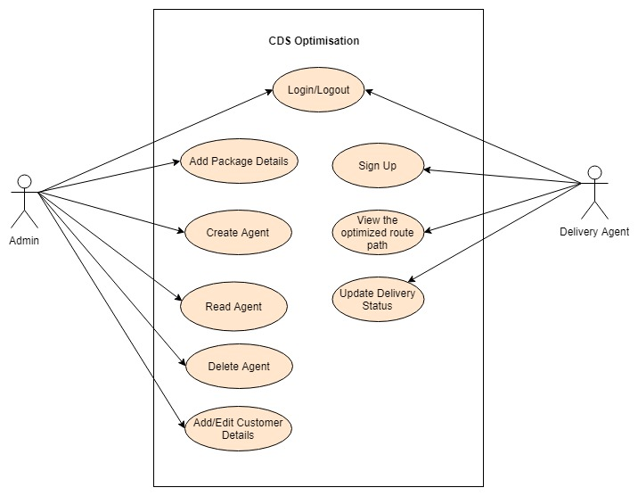
Use Case Diagram

Slide 9
Google Api’s to BE used
Direction API
Distance Matrix API
Maps JavaScript API

Slide 10
Route Optimization process
How should it take decisions ?
Let Delivery boy be at point ‘P’
Let there exist three delivery points as ‘D1’ ‘D2’ ‘D3’.
Here distance between P to D1 = 5 units (light traffic)
Distance between P to D2 = 2 units(Heavy traffic)
Distance between P to D3 = 12 units(Moderate traffic)
Then our system should get the decision that - from P to D1 distance is less and less traffic according to google map so delivery boy can reach there more quick and complete the delivery process

Slide 11
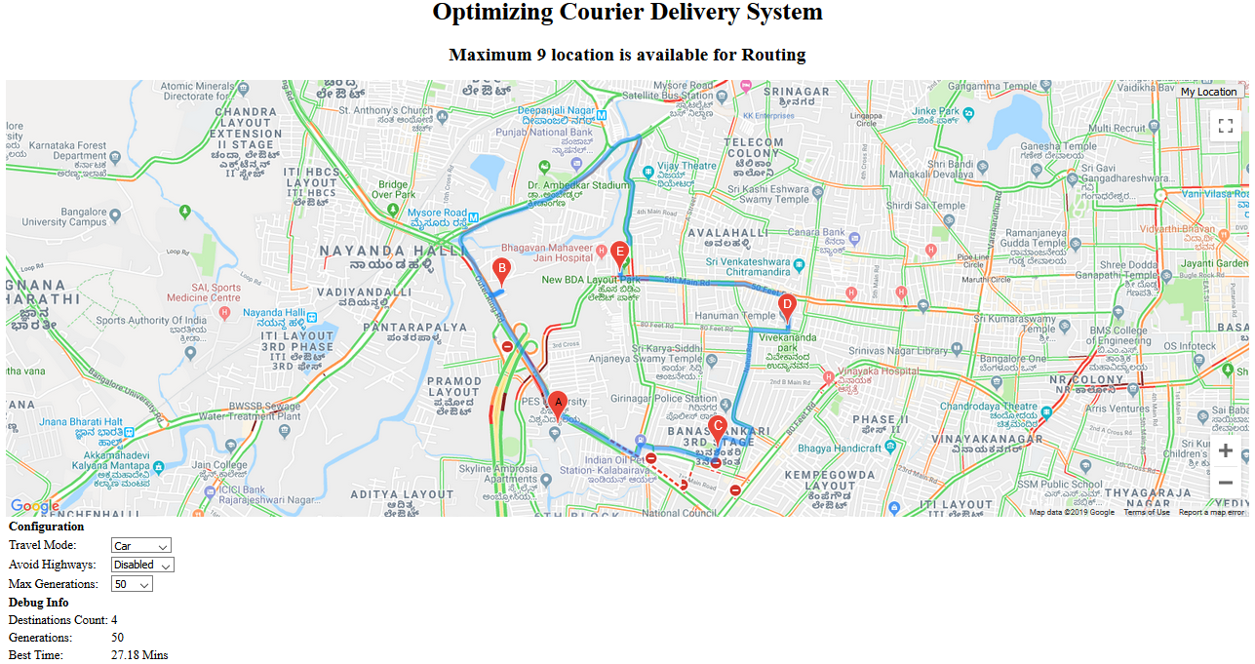
Map demo

Slide 12
TESTING
Test Case ID |  | PES_001 | Test Case Description |  | Test the Login Functionality in Admin Panel
Created By |  | Vijaykumar R Pai | Reviewed By |  | Deepthi S Narayan |  |  | Version |  | 1
QA Tester’s Log
Tester's Name |  | Vijaykumar R Pai | Date Tested |  | 30-Mar-2019 |  |  | Test Case (Pass/Fail/Not Executed) |  | Pass
S # | Prerequisites: |  |  |  | S # | Test Data
1 | Access to Chrome Browser |  |  |  | 1 | E-mail = vijaykumarrpai@gmail.com
2 |  |  |  |  | 2 | Password = 12345678
3 |  |  |  |  | 3
4 |  |  |  |  | 4
Test Scenario | Verify on entering valid email and password, the admin can login
Step # | Step Details |  | Expected Results |  | Actual Results |  |  |  |  |  | Pass / Fail / Not executed / Suspended
1 | Navigate to localhost:3000 |  | Admin login page should open |  | Admin login page is loaded |  |  |  |  |  | Pass
2 | Enter E-mail & Password |  | Credential can be entered |  | Credentials are entered |  |  |  |  |  | Pass
3 | Click Login |  | Admin is logged in |  | Admin logged in successfully |  |  |  |  |  | Pass

Slide 13
Test Case ID |  | PES_002 | Test Case Description |  | Test the Registration form Functionality in Admin Panel
Created By |  | Vijaykumar R Pai | Reviewed By |  | Deepthi S Narayan |  |  | Version |  | 1
QA Tester’s Log
Tester's Name |  | Vijaykumar R Pai | Date Tested |  | 30-Mar-2019 |  |  | Test Case (Pass/Fail/Not Executed) |  | Pass
S # | Prerequisites: |  |  |  | S # | Test Data
1 | Access to Chrome Browser |  |  |  | 1 | Name = Vijaykumar R Pai
2 |  |  |  |  | 2 | E-mail = vijaykumarrpai@gmail.com
3 |  |  |  |  | 3 | Mob-no = 7582455420
4 |  |  |  |  | 4 | Your Address = Blore
 |  |  |  |  | 5 | Password = 12345678
 |  |  |  |  | 6 | Confirm Password = 12345678
Test Scenario | Verify on entering name, email, mob-no, address, password and confirm password, the person can register as admin
Step # | Step Details |  | Expected Results |  | Actual Results |  |  |  |  |  | Pass / Fail / Not executed / Suspended
1 | Navigate to localhost:3000 |  | Admin login page should open and navigate to registration form |  | Admin page loaded and on click navigated to registration page |  |  |  |  |  | Pass
2 | Enter name, email, mob-no, address, password and confirm password |  | Credential can be entered |  | Credentials are entered |  |  |  |  |  | Pass
3 | Click Create account |  | Admin account is created |  | Account created successfully |  |  |  |  |  | Pass

Slide 14
Test Case ID |  | PES_003 | Test Case Description |  | Test adding new package Functionality in Admin Panel
Created By |  | Vijaykumar R Pai | Reviewed By |  | Deepthi S Narayan |  |  | Version |  | 1
QA Tester’s Log
Tester's Name |  | Vijaykumar R Pai | Date Tested |  | 30-Mar-2019 |  |  | Test Case (Pass/Fail/Not Executed) |  | Pass
S # | Prerequisites: |  |  |  | S # | Test Data
1 | Access to Chrome Browser |  |  |  | 1 | Person name = vj
2 |  |  |  |  | 2 | Package name = Laptop
3 |  |  |  |  | 3 | Package number = 5845098591
Test Scenario | Verify on entering name, email, mob-no, address, password and confirm password, the person can register as admin
Step # | Step Details |  | Expected Results |  | Actual Results |  |  |  |  |  | Pass / Fail / Not executed / Suspended
1 | Navigate to localhost:3000 |  | Admin login page should open |  | Admin login page loaded |  |  |  |  |  | Pass
2 | Enter E-mail & Password |  | Credential can be entered |  | Credentials are entered |  |  |  |  |  | Pass
3 | Click Login |  | Admin is logged in |  | Admin logged in successfully |  |  |  |  |  | Pass
4 | Navigate to create section |  | Page is loaded |  | Toggled to create section |  |  |  |  |  | Pass
5 | Enter person name, package name and package number |  | Data is entered |  | Required fields are entered |  |  |  |  |  | Pass
6 | Click Register Parcel |  | Data is stored in DB |  | Data stored successfully into DB |  |  |  |  |  | Pass

Slide 15
Test Case ID |  | PES_004 | Test Case Description |  | Test adding Package list Functionality in Admin Panel
Created By |  | Vijaykumar R Pai | Reviewed By |  | Deepthi S Narayan |  |  | Version |  | 1
QA Tester’s Log
Tester's Name |  | Vijaykumar R Pai | Date Tested |  | 30-Mar-2019 |  |  | Test Case (Pass/Fail/Not Executed) |  | Pass
S # | Prerequisites: |  |  |  | S # | Test Data
1 | Access to Chrome Browser |  |  |  | 1 | Person name = vj
2 |  |  |  |  | 2 | Package name = Laptop
3 |  |  |  |  | 3 | Package number = 5845098591
Test Scenario | Verify on clicking the delete button in package list, the respective package is deleted.
Step # | Step Details |  | Expected Results |  | Actual Results |  |  |  |  |  | Pass / Fail / Not executed / Suspended
1 | Navigate to localhost:3000 |  | Admin login page should open |  | Admin login page loaded |  |  |  |  |  | Pass
2 | Enter E-mail & Password |  | Credential can be entered |  | Credentials are entered |  |  |  |  |  | Pass
3 | Click Login |  | Admin is logged in |  | Admin logged in successfully |  |  |  |  |  | Pass
4 | Navigate to index section |  | Page is loaded |  | Page loaded successfully |  |  |  |  |  | Pass
5 | Click delete to remove a particular package |  | Package is deleted |  | Package deleted successfully |  |  |  |  |  | Pass

Slide 16
Test Case ID |  | PES_005 | Test Case Description |  | Test Agent list Functionality in Admin Panel
Created By |  | Vijaykumar R Pai | Reviewed By |  | Deepthi S Narayan |  |  | Version |  | 1
QA Tester’s Log
Tester's Name |  | Vijaykumar R Pai | Date Tested |  | 30-Mar-2019 |  |  | Test Case (Pass/Fail/Not Executed) |  | Pass
S # | Prerequisites: |  |  |  | S # | Test Data
1 | Access to Chrome Browser |  |  |  | 1 | Person name = vj
2 |  |  |  |  | 2 | Package name = Laptop
3 |  |  |  |  | 3 | Package number = 5845098591
Test Scenario | Verify on clicking the delete button in package list, the respective package is deleted.
Step # | Step Details |  | Expected Results |  | Actual Results |  |  |  |  |  | Pass / Fail / Not executed / Suspended
1 | Navigate to localhost:3000 |  | Admin login page should open |  | Admin login page loaded |  |  |  |  |  | Pass
2 | Enter E-mail & Password |  | Credential can be entered |  | Credentials are entered |  |  |  |  |  | Pass
3 | Click Login |  | Admin is logged in |  | Admin logged in successfully |  |  |  |  |  | Pass
4 | Navigate to agent section |  | Page is loaded |  | Page loaded successfully |  |  |  |  |  | Pass
5 | Click delete to remove a particular agent |  | Agent is deleted |  | Agent deleted from DB successfully |  |  |  |  |  | Pass

Slide 17
Test Case ID |  | PES_006 | Test Case Description |  | Test the Login Functionality in Agent Panel
Created By |  | Ayush Pratyay | Reviewed By |  | Deepthi S Narayan |  | Version |  | 2.1
QA Tester’s Log
Tester's Name |  | Ayush Pratyay | Date Tested |  | 31-03-2019 |  | Test Case (Pass/Fail/Not Executed) |  | Pass
S # | Prerequisites: |  |  |  | S # | Test Data
1 | Access to Chrome Browser |  |  |  | 1 | E-mail id = Ayush@gmail.com
2 |  |  |  |  | 2 | Pass = arpit1
3 |  |  |  |  | 3
4 |  |  |  |  | 4
Test Scenario | Verify on entering valid user id and password, the Agent can login
Step # | Step Details |  | Expected Results |  | Actual Results |  |  | Pass / Fail / Not executed / Suspended
1 | Navigate to http://localhost:3000/ |  | Agent login page should open |  | Agent login page loaded |  |  | Pass
2 | Enter E-mail id & Password |  | Credential can be entered |  | Credentials are entered |  |  | Pass
3 | Click Login |  | Agent is logged in |  | Agent logged in successfully |  |  | Pass

Slide 18
Test Case ID |  | PES_007 | Test Case Description |  | Test the Registration Functionality in Agent Panel
Created By |  | Ayush Pratyay | Reviewed By |  | Deepthi S Narayan |  | Version |  | 2.1
QA Tester’s Log
Tester's Name |  | Ayush Pratyay | Date Tested |  | 31-03-2019 |  | Test Case (Pass/Fail/Not Executed) |  | Pass
S # | Prerequisites: |  |  |  | S # | Test Data
1 | Access to Chrome Browser |  |  |  | 1 | Name = Ayush
2 |  |  |  |  | 2 | Email Id = Ayush@gmail.com
3 |  |  |  |  | 3 | Mob-no = 9876543210
4 |  |  |  |  | 4 | Address = Banshankari
5 |  |  |  |  | 5 | Password = arpit1
6 |  |  |  |  | 6 | Conf password = arpit1
Test Scenario | Verify on entering name, email, mob-no, address, password and confirm password, the person can register as agent
Step # | Step Details |  | Expected Results |  | Actual Results |  |  | Pass / Fail / Not executed / Suspended
1 | Navigate to http://localhost:3000/ |  | Agent registration page should open and navigate |  | Agent login page loaded |  |  | Pass
2 | Enter name, email, mob-no, address, password and confirm password |  | Credential can be entered |  | Credentials are entered |  |  | Pass
3 | Click Register |  | Agent account is created |  | Agent account created successfully |  |  | Pass

Slide 19
Test Case ID |  | PES_008 | Test Case Description |  | Test the Login Functionality in Driver module
Created By |  | Ayush Pratyay | Reviewed By |  | Deepthi S Narayan |  | Version |  | 2.1
QA Tester’s Log
Tester's Name |  | Ayush Pratyay | Date Tested |  | 31-03-2019 |  | Test Case (Pass/Fail/Not Executed) |  | Pass
S # | Prerequisites: |  |  |  | S # | Test Data
1 | Access to Chrome Browser |  |  |  | 1 | E-mail id = Ayush@gmail.com
2 |  |  |  |  | 2 | Pass = arpit1
3 |  |  |  |  | 3
4 |  |  |  |  | 4
Test Scenario | Verify on entering valid userid and password, the Driver can login
Step # | Step Details |  | Expected Results |  | Actual Results |  |  | Pass / Fail / Not executed / Suspended
1 | Navigate to http://localhost:3000/ |  | Driver login page should open |  | Driver login page loaded |  |  | Pass
2 | Enter E-mail id & Password |  | Credential can be entered |  | Credentials are entered |  |  | Pass
3 | Click Login |  | Driver is logged in |  | Driver logged in successfully |  |  | Pass

Slide 20
CONCLUSION
The objective of the project was to solve the difficulties faced by the courier delivery agents as to which courier has to be delivered first, which has been solved with our application as it shows feasible route once the delivery agent enters the location of the package to be delivered based on traffic conditions and time taken. Since our application is built with React JS, it is lightweight, responsive, loads faster once it is deployed.

Slide 21
FUTURE ENHANCEMENT
There are lot of features and functionalities that can be integrated in our project. Firstly, using certain algorithm Machine Learning can be integrated into our project which will train the system in order to pick packages to be delivered based on daily quota and automatically pin point the geo - coordinates on the map based on the location of package to be delivered.
Secondly, we can build a customized app for Android and IOS using React Native which will be more responsive and faster compared to present one.

Slide 22
BIBLIOGRAPHY
https://medium.freecodecamp.org/the-react-handbook-b71c27b0a795
https://medium.com/javascript-in-plain-english/full-stack-mongodb-react-node-js-express-js-in-one-simple-app-6cc8ed6de274
https://appdividend.com/category/react-js/
https://www.npmjs.com/package/node-sms-send
https://stackoverflow.com/questions/42444909/which-is-the-best-place-to-learn-react-js
Software Engineering – A Practitioner’s Approach, Roger S Pressman
React.js Essentials – Artemij Fedosejev

Slide 23
Thank You

